Slide 1

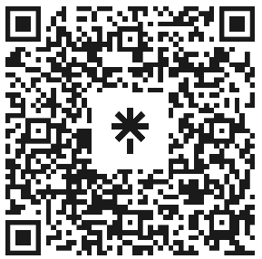

Welcome to Code Crunch!
C11 | CRUNCH ARCADE
[Tuesdays 3-4 PM]/[Wednesdays 10-11 AM] Weekly | Spring 2025
Attendance
linktr.ee/CODE.CRUNCH

Slide 2
Unit #1
C[11] | [ CRUNCH ARCADE ]
Introduction to Crunch Arcade and Unity

Slide 3
Welcome to Code Crunch!
Code Crunch is your go-to platform for collaboration, networking, and hands-on projects. We welcome freshmen, graduates, and alumni from any university, regardless of major or experience level.
﻿Join us virtually via Zoom or in-person at Florida International University. Together, we'll break down barriers in technology, learn through immersive workshops, and build innovative solutions.

Slide 4
Our Mission & Vision
Mission:
Our mission is to equip students with the technical skills and professional connections needed to excel in coding interviews and beyond. We provide a platform where students can collaborate, learn, and grow professionally while emphasizing the importance of diversity and inclusion in the tech industry vision.
We strive to bridge the gap between academia and the tech industry by offering hands-on workshops, technical interview preparation, hackathons, and networking opportunities with experts from leading companies. Our vision is to empower students from all backgrounds to achieve their full potential, foster an inclusive tech community, and build a strong, supportive alumni network. By covering a wide range of technical areas, we aim to prepare students for success in a variety of tech careers.

Slide 5
What We Offer
• Hands-On Workshops: Topics include Python, JavaScript, React, and more.
• LeetCode Prep: Weekly sessions to master technical interviews.
• Hackathons: Collaborate on innovative projects in a competitive setting.
• Panel Discussions: Industry leaders from tech giants and startups share insights.
• Global Access: Code Crunch Global launches in October for worldwide participation!

Slide 6
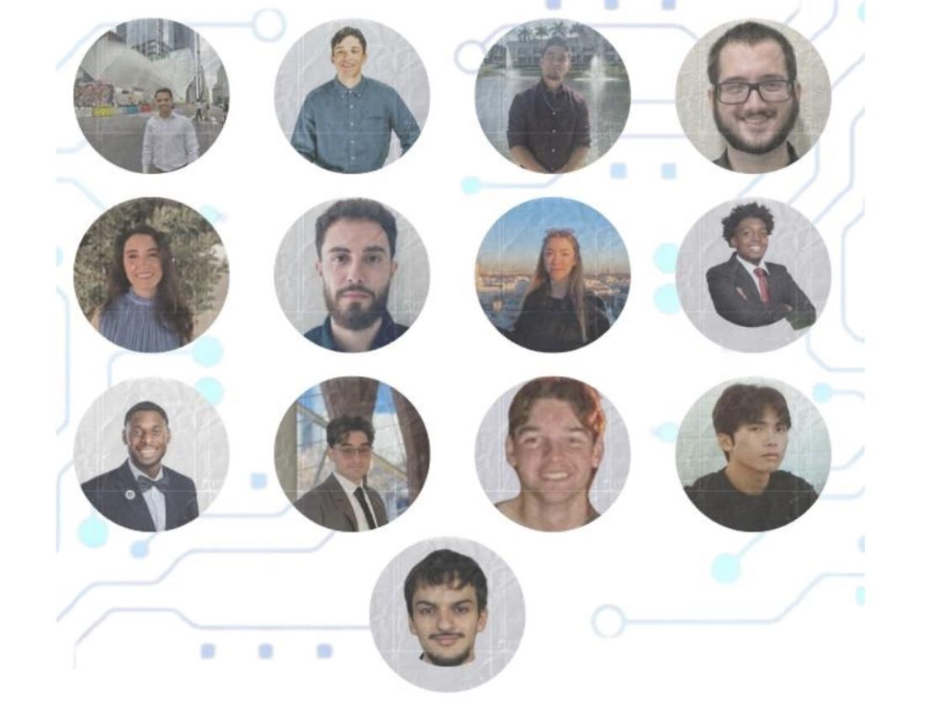

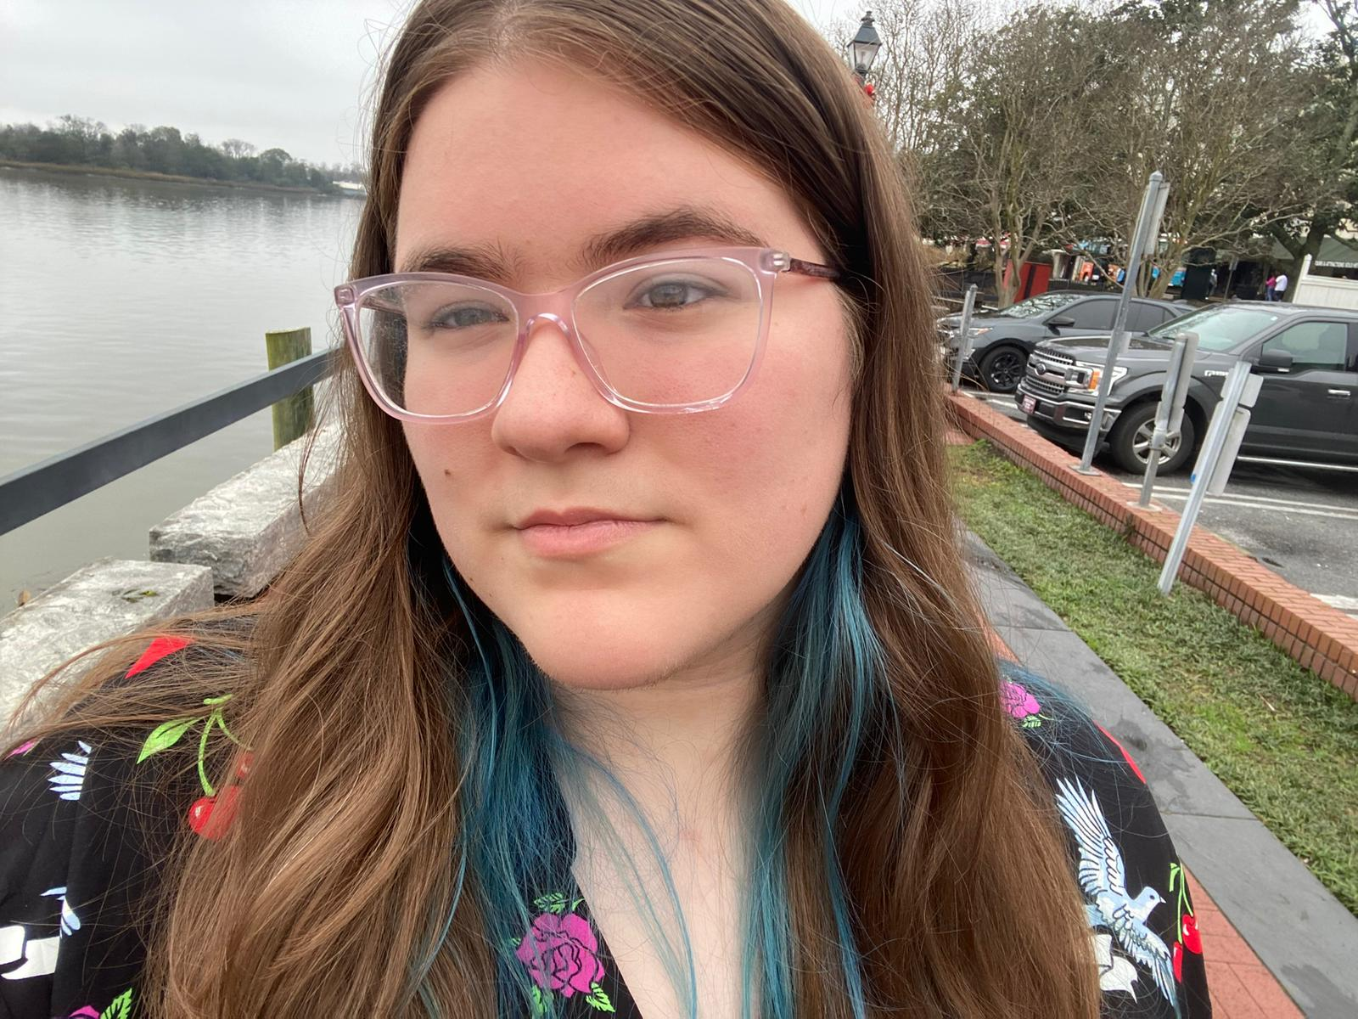
Meet the E-Board
● President: Brian Bazurto
● Vice President: Amilcar Pena
● Treasurer: Bryan Garcia
● Marketing/Logistics: Mariana Phelan
Tech. Engagement Chairs:
● Amilcar Pena
● Daniel Hernandez
● Arnold Miranda-Pino
● Sara Salvatierra
● Gabriel Nogueras
● Justin Joseph
● Thierry Laguerre
● Johan Gonzalez
● Ashley Prado
● Gabriela Machado
● Jason Jiang
● Henry Cruz

Slide 7
Why Join Code Crunch?
• Collaborate with peers and mentors.
• Develop technical and leadership skills.
• Network with professionals from top companies.
• Build impactful projects and gain hands-on experience.
A welcoming and inclusive space for underrepresented groups in tech.

Slide 8

Spring 2025 Weekly Schedule

Slide 9
Be Part of the Code Crunch Community
1. RSVP for sessions at go.fiu.edu/codecrunch.
2. Follow us on LinkedIn, Instagram, and Discord for updates.
3. Become a member using the QR code on this slide.
4. Attend workshops, participate in events, and join our leadership team.
Together, we innovate and grow.

Slide 10
What we offer at C11 Crunch Arcade
This 7-week Unity course is designed to take you from a complete beginner to a confident game developer with a fully functional game of your own.
We will guide you through the essential skills needed to bring your ideas to life, including game design principles, C# scripting, UI development, environment creation, AI implementation, and game polishing techniques.
By the end of this course, you will not only have a finished project to showcase but also a solid understanding of Unity’s tools and workflows.
Whether you dream of creating your own indie game, breaking into the game development industry, or simply exploring your creativity, this course will give you the foundation you need to get started!

Slide 11
Key Dates and Structure
C11 - Crunch Arcade
Week 1: Introduction to Unity & Game Development
Learning what Unity is, installing Unity Engine and necessary modules for setup.
Week 2: Unity Components & Scripting Basics
Understanding physics, collisions, and writing your first C# scripts.
Week 3: UI & Playable Character
Creating UI elements, adding score systems, and implementing player movement.
Week 4: Environment Design & Interaction
Designing terrain, adding collectibles, and building game logic.
Week 5: AI & Gameplay Mechanics
Introducing enemies, adding combat, and designing levels.
Week 6: Sound, Visual Effects & Testing
Implementing audio, particle effects, and playtesting for final adjustments.
Week 7: Final Project Showcase
Presenting your game, sharing your experience, and receiving feedback.

Slide 12

Starting off…
Let’s Get Started! :D

Slide 13


Installations!
Let's start off first by downloading Unity and its necessary components.
Head to: https://unity.com/download, and select either download for Windows, Mac or Linux depending on your system.
Then make a free account, and install the Unity Editor.
After installing, go to “Your Installs” and select the icon (on the right) and click on “Add modules.”
Select “Microsoft Visual Studio Community 2022” -- this will be used for scripting.
Within the installation wizard, scroll down to the “Gaming” section and choose: “Game development with Unity” and hit the install button.

Slide 14
While that’s installing...
What is Unity exactly, and why?

Slide 15
Unity Lore and Overview
What is Unity?
A cross-platform game engine developed by Unity Technologies.
It is mainly used for creating 2D, 3D, AR, and VR applications.
Background Information:
First released in 2005 as an Apple-exclusive engine.
Expanded to support multiple platforms, now a leading game engine.
Uses C# as its primary programming language.
What is it Used For?
Game development (PC, mobile, console, AR/VR).
Real-time simulations, architectural visualization, film, and interactive media.
Industry Impact:
Powers over 50% of mobile games and nearly half of all games.
Used by indie developers and major studios alike.
Integral to emerging technologies like AR/VR and metaverse applications.
Key Concepts in Game Development:
GameObjects & Components – The building blocks of a Unity game.
Scripting (C#) – Controls gameplay mechanics and interactions.
Physics & Collisions – Enables movement, gravity, and interactions.
UI & User Interaction – Menus, buttons, and player feedback.

Slide 16
End of Unit 1!
That’s end of today’s workshop.

Slide 17

Q&A Session

Slide 18





Attendance
Join us for the upcoming weekly sessions this Spring 2025!
(Jan 6 - Apr 4, 2025)
Monday: C5 1PM / C3 2PM
Tuesdays: C7 1PM
Wednesdays: C5 1PM / C1 2PM
Thursdays: C6 1PM / C4 2PM / C8 3PM
Friday: C2 1PM / C9 2PM / C10 3PM
RSVP LU.MA/CODECRUNCH
Your feedback helps us improve. Share your thoughts! Go to our website: go.fiu.edu/codecrunch

